Slide 1
Name the location in the UK from the emojis

Slide 2

Example…..

Slide 3
Answer: BATH

Slide 4

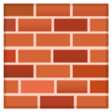
Clue 1

Slide 5


Clue 2

Slide 6


Clue 3

Slide 7


Clue 4

Slide 8


Clue 5

Slide 9


Clue 6

Slide 10
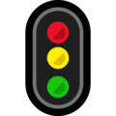

Clue 7

Slide 11


Clue 8

Slide 12


Clue 9

Slide 13


Clue 10
🌉

Slide 14


Clue 11

Slide 15

Clue 12

Slide 16



Clue 13

Slide 17

Clue 14

Slide 18

Clue 15

Slide 19


Clue 16

Slide 20


Clue 17

Slide 21


Clue 18

Slide 22


Clue 19

Slide 23


Clue 20

Slide 24










THE END! And the top 10 Emojis of 2020

